Slide 1
期末報告書
組員:
1112040蔡東廷
1112007鍾承謙
1112042鍾曜蓬
1112030林昱賢
1082056鍾柏元
指導老師:張家榮

Slide 2
目錄
1.網站資訊
2.執行進度
3.開會討論
4.已/未完成部分

Slide 3
一.網站資訊

Slide 4


網站名稱:元智life
logo:

Slide 5
緣由:
專門準備對還沒準備好大學生活的新生們一個熟悉本校周邊的網站。
理念:
主要是統整及收集資料的網站，但也會加入些許互動來使網站更有趣
目標對象:
即將或已經就讀元智大學的學生。

Slide 6
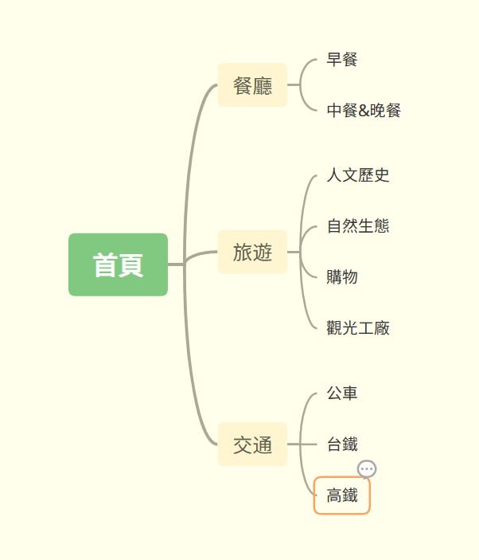
網站關係圖

Slide 7
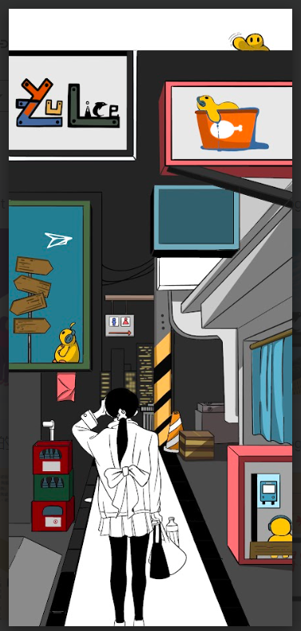
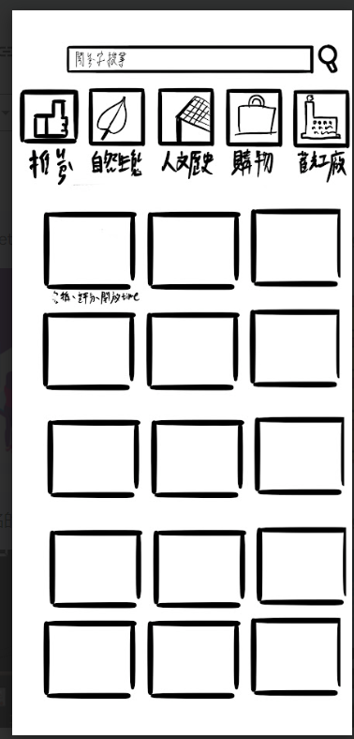
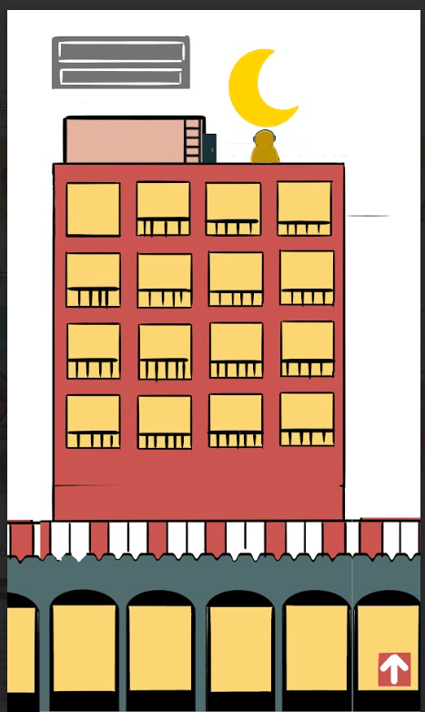
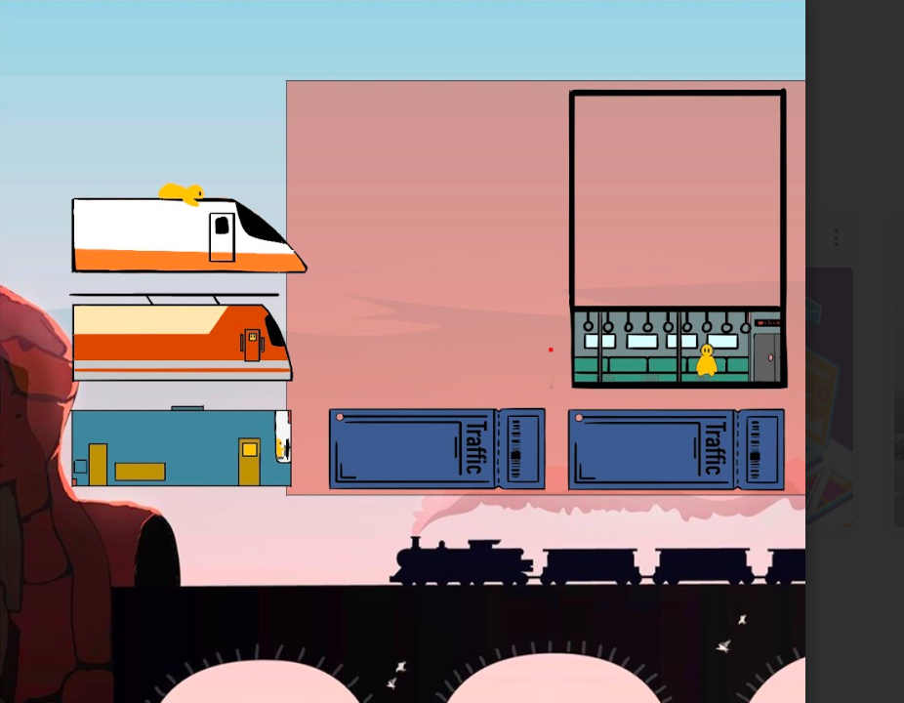
網頁美術

Slide 8
二.執行進度

Slide 9
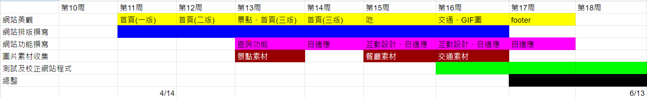

Slide 10
負責事項
蔡東廷:網頁程式編寫
鍾承謙:排版、插畫繪製
林昱賢:排版、資料收集
鍾曜蓬:資料收集、信息彙整
鍾伯元:偵錯、時間規劃

Slide 11
三.開會討論

Slide 12
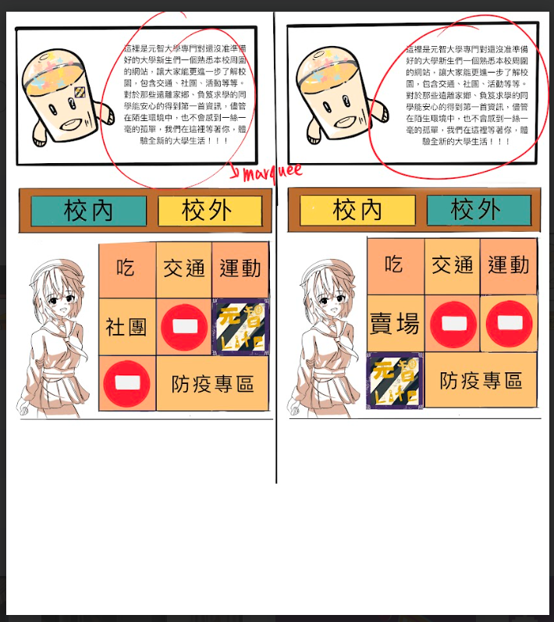
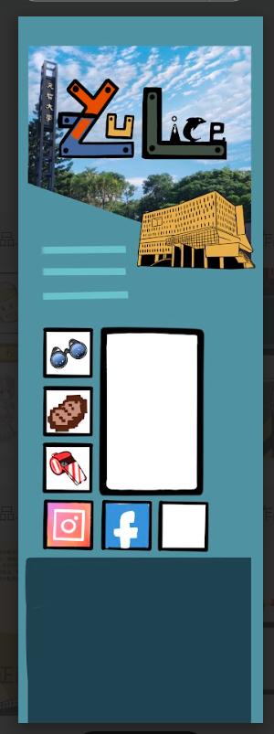
首頁三版
首頁一版
首頁二版

Slide 13
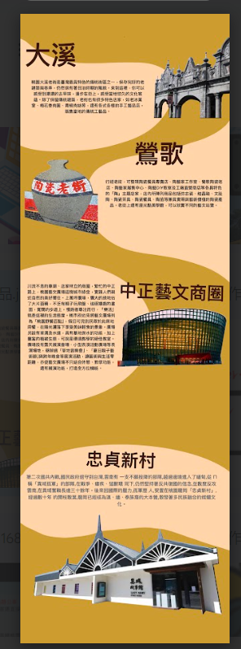
景點一版
景點二版

Slide 14
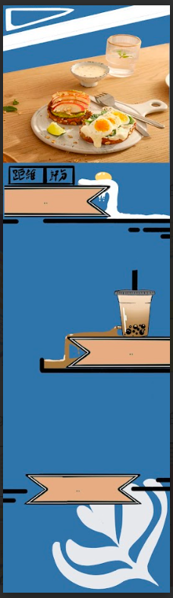
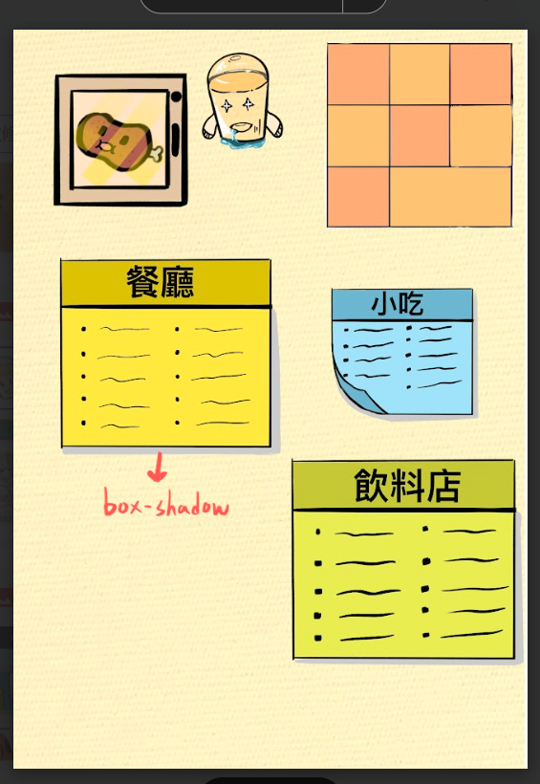
餐廳一版
餐廳二版

Slide 15
餐廳三版

Slide 16
四.已/未完成項目

Slide 17
已完成項目
01.

Slide 18

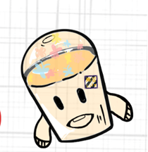
logo設計
期中
期末

Slide 19
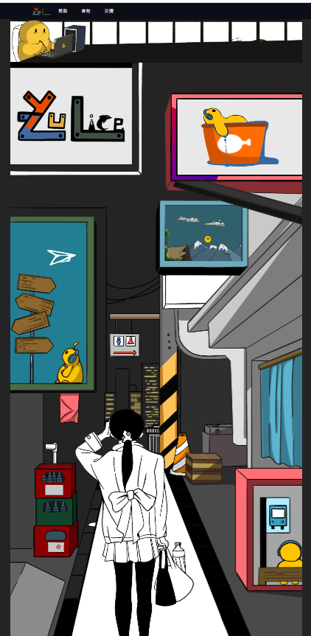
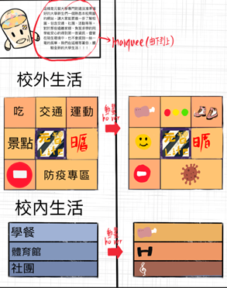
首頁
期中
期末

Slide 20
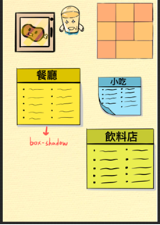
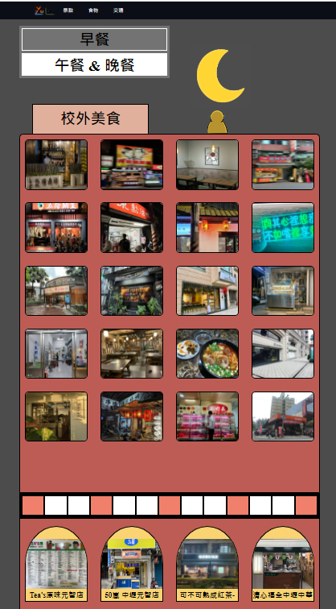
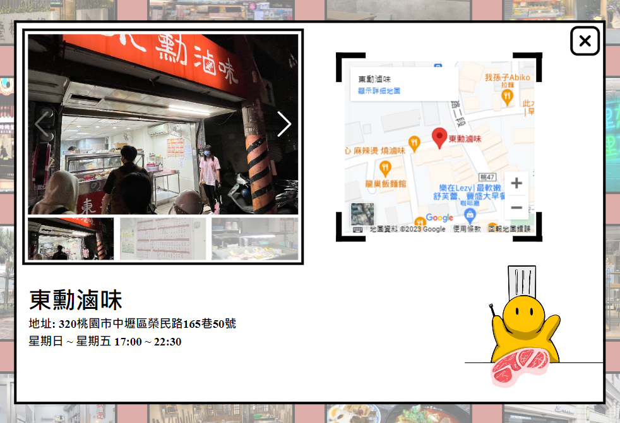
餐廳
期中
期末
2015

Slide 21
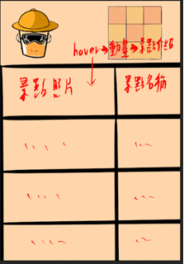
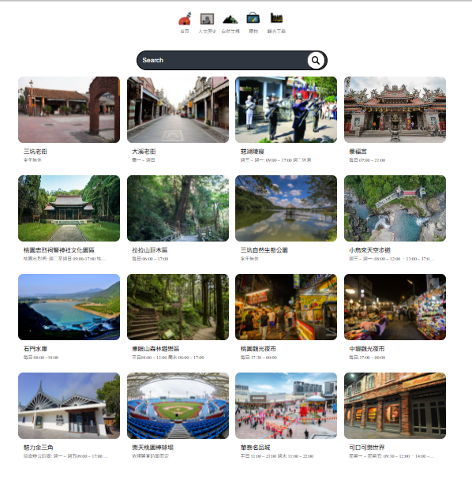
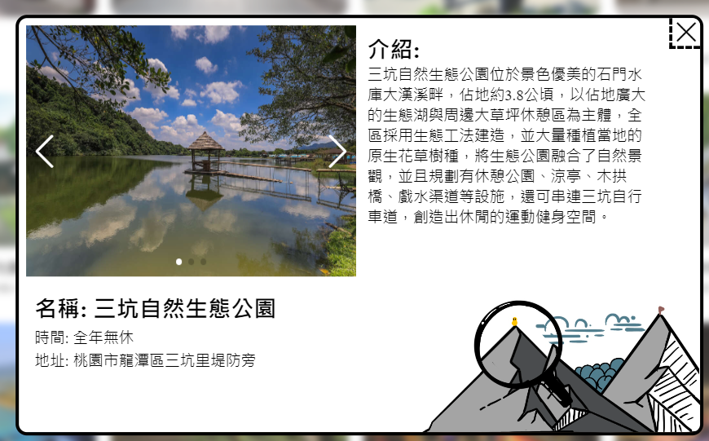
景點
期中
期末
2015

Slide 22
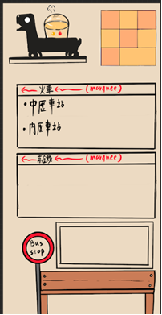
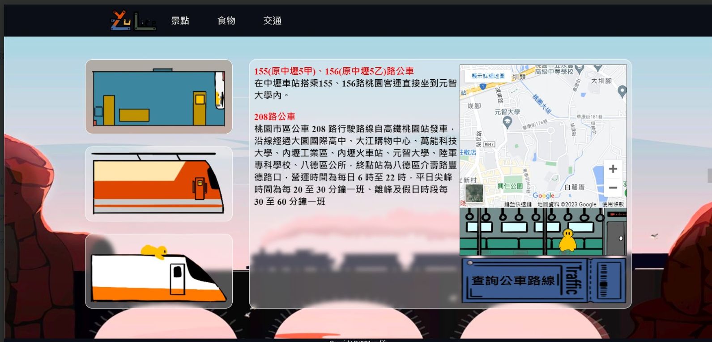
交通
期中
期末
2015

Slide 23
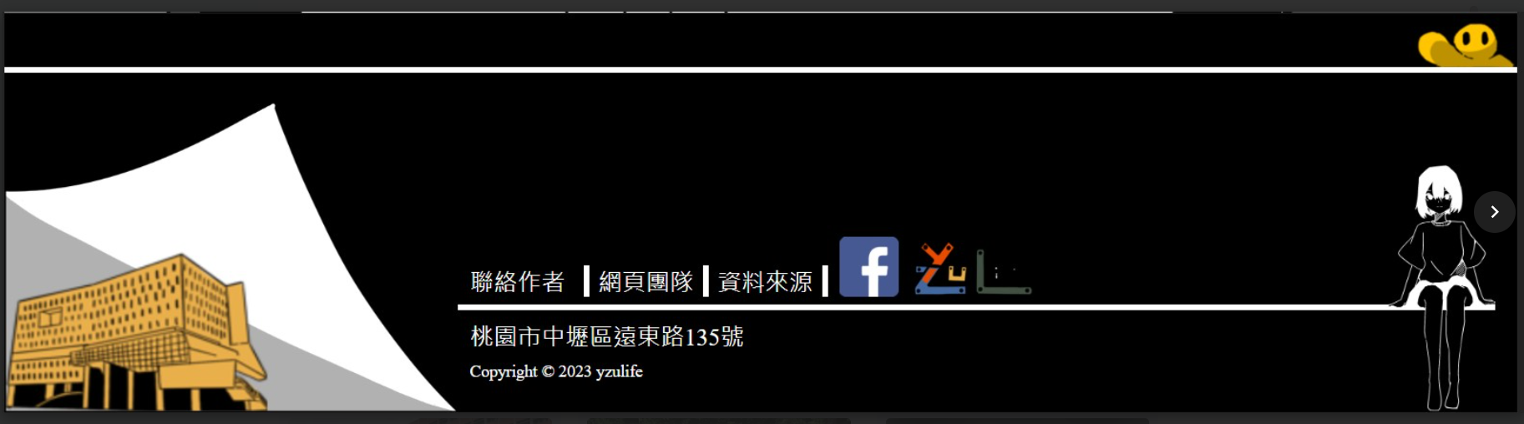
FOOTER
期中
期末
未設計

Slide 24
未完成項目
02.

Slide 25
校內
未完成原因:
1.資料過少。
2.非必要性。
3.優先考慮網頁質量。
運動
防疫

Slide 26
五.遭遇問題

Slide 27
1.多次調整排版與美術設計
2.
3.
4.
5.

Slide 29
What They Say About Us?
“Jupiter is a gas giant and the biggest planet in our Solar System. It’s the fourth-brightest object in the sky”
JENNA DOE, 32
“Venus has a beautiful name and is the second planet from the Sun. It’s terribly hot, even hotter than Mercury”
HELENA PATTERSON,43
“Despite being red, Mars is a cold place, not hot. It’s full of iron oxide, which gives the planet its reddish cast”
JOHN JAMES, 24

Slide 30

A Picture is Worth a Thousand Words

Slide 31
333,000.00
Big numbers catch your audience’s attention

Slide 32
This is a Table
Mars | 0.5 | 0.14 | 1.6
Saturn | 3.4 | 2.5 | 1.2
Mercury | 0.7 | 1.2 | 3.5

Slide 33
Case Studies
Opportunity
Despite being red, Mars is a cold place, not hot
Proffer
Mercury is the closest planet to the Sun
Implantation
Venus has a beautiful name and is the second planet

Slide 34
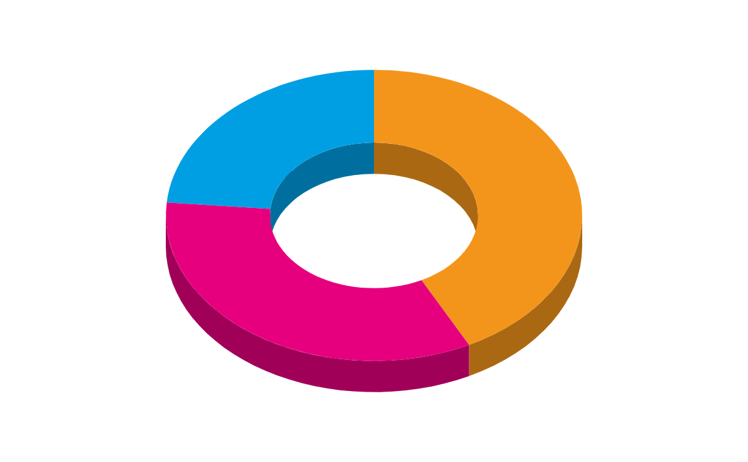
Our Target
Venus
Mars
Mercury is the closest planet to the Sun
Despite being red, Mars is a cold place, not hot
Saturn
Saturn is the ringed one. It’s a gas giant
If you want to modify this graph, click on it, follow the link, change the data and replace

Slide 35
Where are we located?
01
Venus is the second planet
02
Mercury is the closest planet
03
Mars is a cold place, not hot.

Slide 36
Percentages
50 %
Mercury is the closest planet to the Sun
45 %
25 %
Despite being red, Mars is a cold place
Saturn is the ringed one. It’s a gas giant

Slide 37

A Picture Always Reinforces the Concept

Slide 38
Awards
Saturn
Venus
Mercury
Here you could talk about this achievement
Here you could talk about this achievement
Here you could talk about this achievement
Jupiter
Mars
Neptune
Here you could talk about this achievement
Here you could talk about this achievement
Here you could talk about this achievement

Slide 39
Meet the Team
HELENA JAMES
You can replace the image on the screen with your own
JOHN DOE
You can replace the image on the screen with your own
JAMES PATTERSON
You can replace the image on the screen with your own

Slide 40
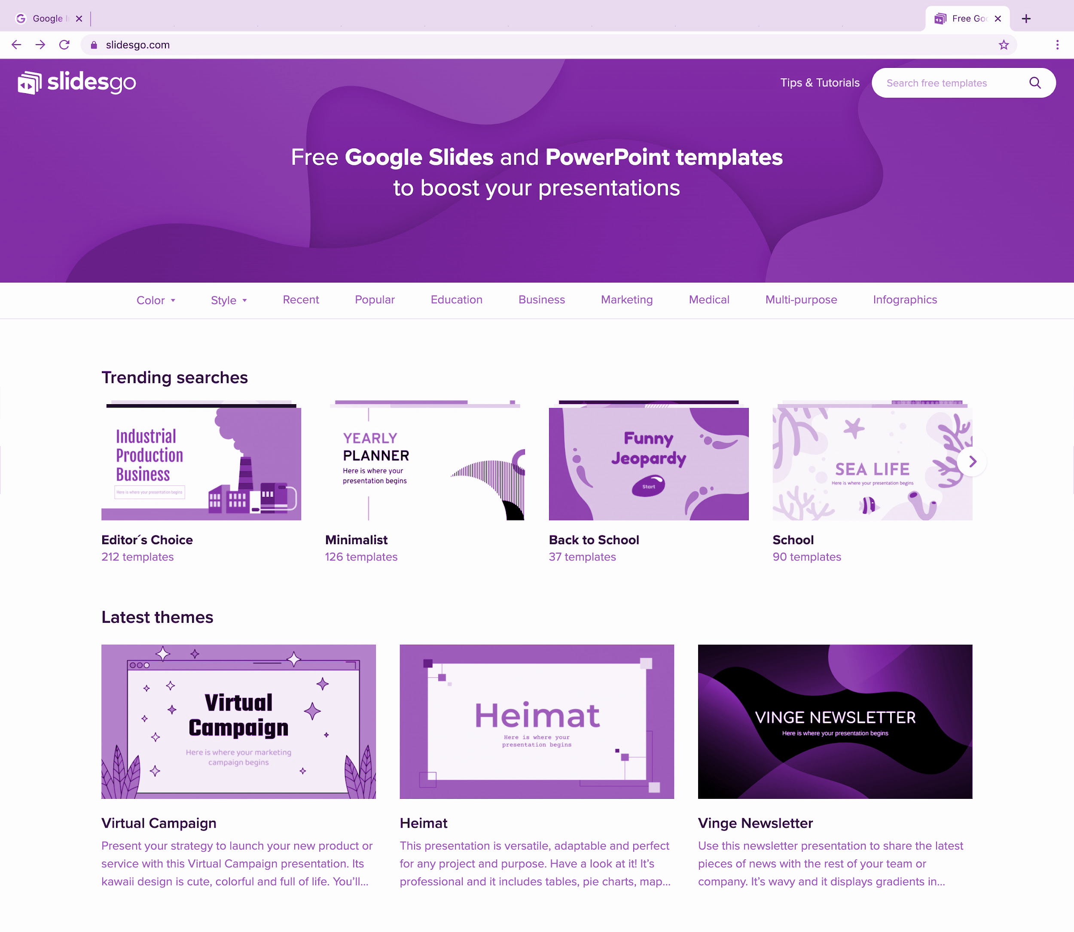
Laptop Software
You can replace the image on the screen with your own work. Just delete this one, add yours and send it to the back

Slide 41
Thanks !
Do you have any questions?
youremail@freepik.com +91 620 421 838 yourcompany.com
Please keep this slide for attribution

Slide 42
Alternative Resources
VECTORS:
Business strategies isometric landing page
Isometric teamwork landing page template
Isometric business people
PHOTOS:
Hacker typing on laptop
Close-up of humans handshake with tech background
Close up of hacker typing on laptop

Slide 43
Resources
Did you like the resources on this template? Get them for free at our other websites.
Vectors:
Isometric infographic steps template
Business analysis professional landing page
Business statistics isometric landing page
Isometric marketing strategy landing page
5g technology landing page in isometric
Electronic devices mock-ups
Photos
Close up of hacker
Blonde influencer posing

Slide 44
Instructions for use (free users)
In order to use this template, you must credit Slidesgo by keeping the Thanks slide.
You are allowed to:
Modify this template.
Use it for both personal and commercial purposes.
You are not allowed to:
Sublicense, sell or rent any of Slidesgo Content (or a modified version of Slidesgo Content).
Distribute this Slidesgo Template (or a modified version of this Slidesgo Template) or include it in a database or in any other product or service that offers downloadable images, icons or presentations that may be subject to distribution or resale.
Use any of the elements that are part of this Slidesgo Template in an isolated and separated way from this Template.
Delete the “Thanks” or “Credits” slide.
Register any of the elements that are part of this template as a trademark or logo, or register it as a work in an intellectual property registry or similar.
For more information about editing slides, please read our FAQs or visit Slidesgo School:
https://slidesgo.com/faqs and https://slidesgo.com/slidesgo-school

Slide 45
Instructions for use (premium users)
In order to use this template, you must be a Premium user on Slidesgo.
You are allowed to:
Modify this template.
Use it for both personal and commercial purposes.
Hide or delete the “Thanks” slide and the mention to Slidesgo in the credits.
Share this template in an editable format with people who are not part of your team.
You are not allowed to:
Sublicense, sell or rent this Slidesgo Template (or a modified version of this Slidesgo Template).
Distribute this Slidesgo Template (or a modified version of this Slidesgo Template) or include it in a database or in any other product or service that offers downloadable images, icons or presentations that may be subject to distribution or resale.
Use any of the elements that are part of this Slidesgo Template in an isolated and separated way from this Template.
Register any of the elements that are part of this template as a trademark or logo, or register it as a work in an intellectual property registry or similar.
For more information about editing slides, please read our FAQs or visit Slidesgo School:
https://slidesgo.com/faqs and https://slidesgo.com/slidesgo-school

Slide 46
Fonts & colors used
This presentation has been made using the following fonts:
Anton
(https://fonts.google.com/specimen/Anton?query=anton)
Lato
(https://fonts.google.com/specimen/Lato?query=lato)
#009fe3
#e6007e
#f4951b
#662483

Slide 47




Stories by Freepik
Create your Story with our illustrated concepts. Choose the style you like the most, edit its colors, pick the background and layers you want to show and bring them to life with the animator panel! It will boost your presentation. Check out How it Works.
Pana
Amico
Bro
Rafiki

Slide 48
Use our editable graphic resources...
You can easily resize these resources without losing quality. To change the color, just ungroup the resource and click on the object you want to change. Then, click on the paint bucket and select the color you want. Group the resource again when you’re done. You can also look for more infographics on Slidesgo.

Slide 51
JANUARY
FEBRUARY
MARCH
APRIL
MAY
JUNE
PHASE 1
Task 1
Task 2
PHASE 2
Task 1
Task 2
JANUARY
FEBRUARY
MARCH
APRIL
PHASE 1
Task 1
Task 2

Slide 54
...and our sets of editable icons
You can resize these icons, keeping the quality.
You can change the stroke and fill color; just select the icon and click on the paint bucket/pen.
In Google Slides, you can also use Flaticon’s extension, allowing you to customize and add even more icons.

Slide 55
Educational Icons
Medical Icons

Slide 56
Business Icons
Teamwork Icons

Slide 57
Help & Support Icons
Avatar Icons

Slide 58
Creative process Icons
Performing Arts Icons

Slide 59
Nature Icons

Slide 60
SEO & Marketing Icons

Slide 61


